Slide 1

Code Refactoring and Bug Fixing

Slide 2
About me
Hi there! I’m Pranav [IN1240543], a 24-year-young data enthusiast, pursuing Data Science Course . Sure, I might be fresh, but I'm your one-stop shop for unlocking insights from numbers.
Feel free to reach out! I'm always down to connect with you all. ☺
linkedin
Github

Slide 3
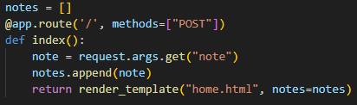
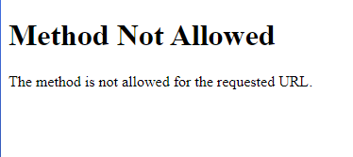
Task Refactor the existing codebase and ensure the proper functioning of the Note Taking Application. Document all identified bugs during the debugging process.
Debugging
Debugging is the process of identifying and fixing errors, or bugs, in software code. It is an essential skill for software developers and involves systematically locating and resolving issues that prevent the code from functioning correctly.
Debugging is an iterative and systematic process that requires patience, attention to detail, and problem-solving skills. By employing a combination of techniques and strategies, developers can effectively identify and resolve bugs, leading to more robust and reliable software.
First we shall look at the provided Python code then we shall move on to the HTML code.
Bugs in th Python code and their fixes
Detected an error in the method provided for the ‘/’ route ->
PROBLEM : The method provided for this route is only ‘POST’ which is a method that is used to submit data to be processed to a specified resource. It sends data in the request body and is commonly used for creating or updating resources on the server. When running the application, the type of request being sent to the route is “GET” but the route currently is only capable of listening to “POST” requests.

Slide 4
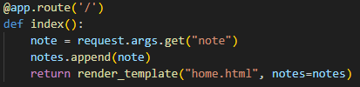

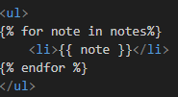
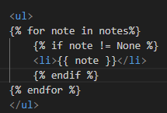



Fix : Since this route is not only adding data to the notes list but also displaying that data on the web page, we shall remove the ‘methods’ parameter and set it back to default which is ‘GET’.
Detected an error in the HTML code
Problem : The codebase provided was displaying ‘None’ as an item of the list.
Fix : Using Jinja templating in the HTML code, added a condition that the notes list will only be displayed if the list item is not equal to None i.e. list should not be empty.
Detected an error in the HTML code
Problem : The form tag in the HTML code was not having a “Submit” button to submit details from the client to the server.
Fix: Added the “Submit” button.
Quality of Life Change -> The title of the page was “Document”. ,
Changed that to “Note Taking APP”.

Slide 5

THANK YOU

